Slide 1
Active supervision
Mary dowling

Slide 2
Head start child supervision requirements
1302.47 Safety Practices (5)(iii)
  Appropriate indoor and outdoor supervision of Children at all times
1302.90 Personnel Policies. (c)(1)(v)
  Ensure no child is left alone or unsupervised by staff, consultants, contractors, or volunteers while under their care.

Slide 3
Prevention framework
CHILD
ADULT
ENVIRONMENT

Slide 4
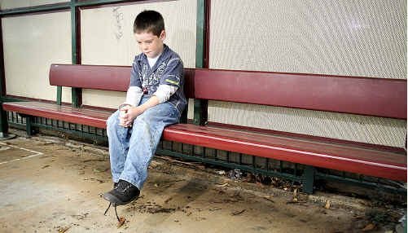
REMEMBER A TIME…
When a child may have been, or almost was, left unattended.
  Were there any circumstances or factors that might have predicted a child might have been left unattended?
  What could you have done to prevent it?

Slide 5
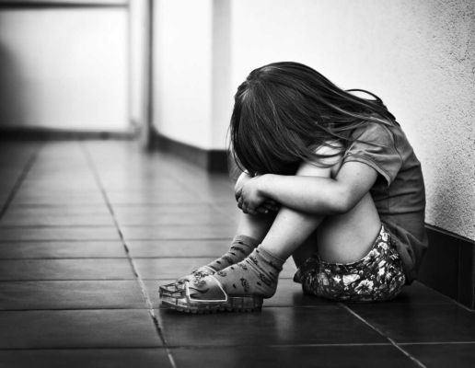
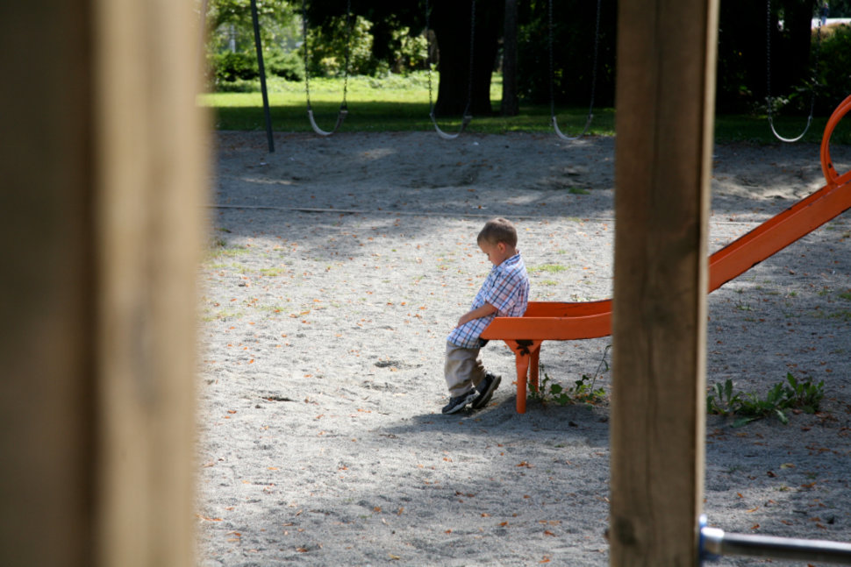
Leaving children unattended can be predicted and prevented

Slide 6
EVERYBODY HAS A ROLE IN A CULTURE OF SAFETY

Slide 7
10 actions to create a culture of safety
Use Data to Make Decisions
Actively Supervise
Keep Environments Safe and Secure
Make Playgrounds Safe
Transport Children Safely
Report Child Abuse and Neglect
Be Aware of Changes that Impact Safety
Model Safe Behaviors
Teach Families about Safety
Know your Children and Families

Slide 8

Actively supervise

Slide 9
What is active supervision?
Set up the environment
Position staff
Scan and count
Listen
Anticipate children’s behavior
Engage and redirect

Slide 10
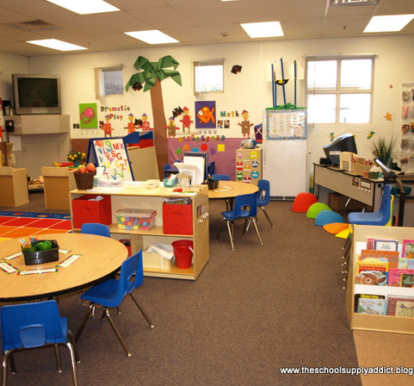
Set up the environment
Unobstructed sightlines
Child-sized furniture
Free of clutter
Clear pathways

Slide 11

Position staff
See and hear all children
Stay within easy reach
Attend to children who may need additional support

Slide 12
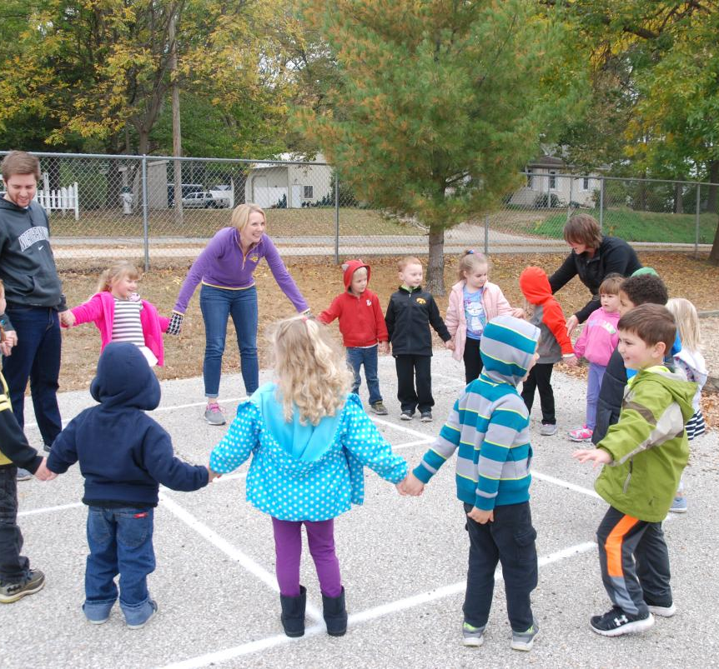
Scan and count
Staff are always able to account for the children in their care. They continually scan the entire environment to know where everyone is and what they are doing. They count the children frequently. This is especially important during transitions.

Slide 13
What is a fail safe or redundant system?
“A part that has the same function as another part and that exists so that the entire system will not fail if the main part fails”
-Merriam webster dictionary
Notes:
Counting children and taking roll call whenever children transition in and out of classrooms or building and on all transitions related to off-site field trips

Slide 14

listen
Specific sounds or the absence of them may signify reason for concern. Staff who are listening closely to children immediately identify signs of potential danger. Think systematically about potential dangers and implement strategies to safeguard children.

Slide 15

anticipate
Know children’s individual interests and skills
Recognize challenges
Offer support
Staff who know what to expect are better able to protect children from harm.

Slide 16

Engage and redirect
Promote problem solving
Tailor assistance
Provide alternate choices

Slide 17
Arias’ story
Aria is a 2 ½ year old who is learning to use the toilet. She attends a center-based program from 8am-6pm every day. The program offers extended hours, but most children arrive by 9am and leave by 5pm, allowing the program to combine classrooms in the morning and evening.
One evening, the remaining children in Aria’s toddler class move in to the preschool room next door. Aria’s teacher leaves for the day. The preschool teacher and a substitute are supervising 12 mixed-age children together. The story area and the small manipulatives are available to use while the substitute is cleaning up the rest of the room. Aria decides she has to use the bathroom.

Slide 18
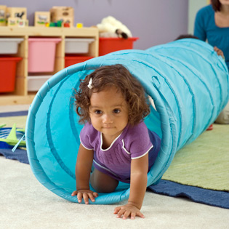
Active supervision self-reflection
Think about how something like Aria’s story might happen in your program.
How do you teach active supervision strategies and support educators to apply these skills every day to avoid unsafe situations?

Slide 19
In summary
We MUST keep full “attention buckets” by knowing how to focus and maintain attention. To do this identify & limit distractions as these cause leaks in your “attention bucket.”
REMEMBER: Transitions, especially out of classroom ones, are when the most common incidents of children being left unattended occur.
WCAP classrooms will use a two-step accountability process which will include counting children and taking roll call during all transitions to and from classrooms. This will be done out loud and engage children in the process.
Subs and volunteers will count children after entering the classroom and confirm number with teacher. IMPORTANT: subs, volunteers, new staff do not have the relationship with children or know them well enough to know how to individualize for them. Children who are at greater risk for unsafe behaviors should not be put in the direct care of subs, volunteers or new staff due to this higher risk.
Supervisors, coordinators and managers will ask teachers how many children are present when visiting classrooms.
PREDICT>>>>>>>PREVENT! Everyone has a role in a culture of safety!

